Slide 1


Slide 2


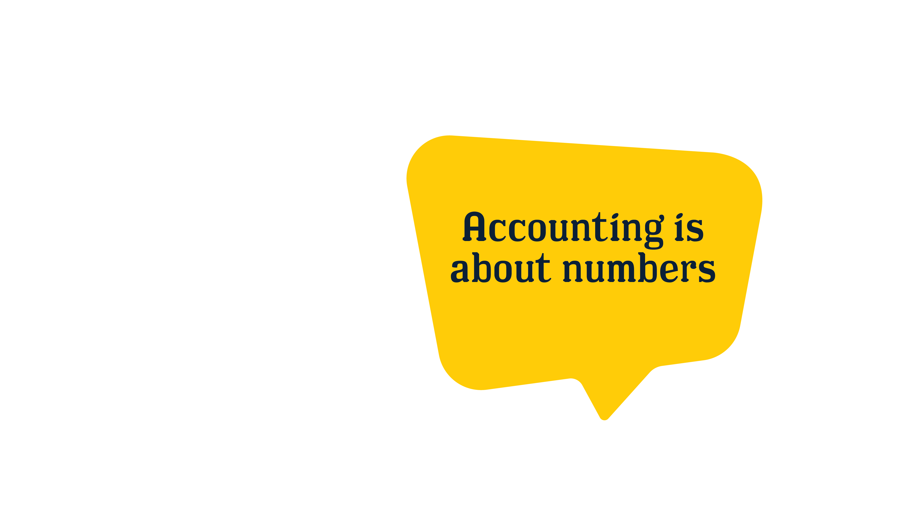
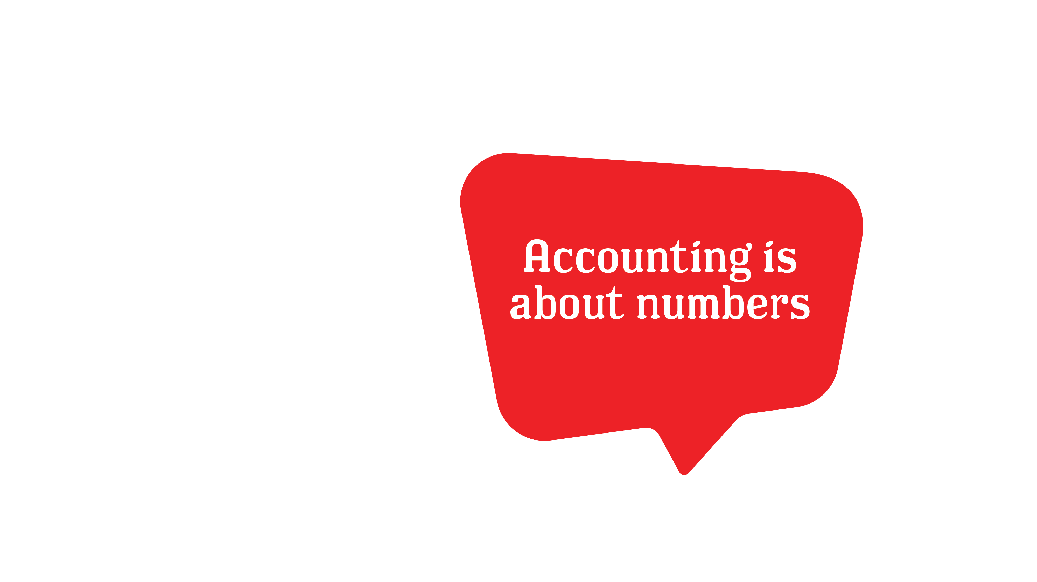







Notes:
Introduction- We’re going to tackle some common myths and give you a clearer picture of what a career in accounting is really like. After I read the myth, thumbs up if it is true and thumbs down if it is not. Let’s dive into the first myth.
Myth 1: Accounting is just about numbers. (MYTH)
Description: Sure, accountants work with numbers, but that is only a piece of what they do. It’s more like solving puzzles! Accountants help people figure out money matters, make smart choices, and keep everything on track. If you like figuring things out, accounting could be your jam! It’s about understanding the story behind the numbers, not just calculating them.
Myth 2: Accounting is a “desk job”. (MYTH)
Description: Accountants are not confined to desks; they actively engage with clients, attend cool events, and sometimes even travel the world. It’s a job that can take you places—literally!
Myth 3: Accountants only do taxes and audits. (MYTH)
Description: Performing tax work is just one career option in accounting. Accountants can work on crime cases (like a money detective!), help businesses grow, or even manage finances for celebrities. There’s a whole world of possibilities beyond taxes.
Myth 4: Accounting could give me the opportunity of a career in sports, music, gaming, and fashion. (TRUE)
Description: Accountants work in every single industry - sports teams, movie studios, you name it. Whatever your passion, a career in accounting blends financial savvy with the industries of your dreams.
Recap- So there you have it! Accounting is a diverse and engaging field with opportunities beyond the usual myths. Let’s move on to explore more about what accountants do and how you can fit into this exciting career!

Slide 3








Notes:
Introduction- Imagine you're playing a video game managing a virtual city. You must ensure everyone has enough money to build cool things like parks, schools, and sports arenas. Now, think of an accountant as the person who helps the real world do just that—but with actual money!
Money Detective: Solve financial mysteries and crimes
Description: Accountants help solve financial mysteries and investigate financial crimes, ensuring everything is above board and uncovering any discrepancies such as fraud, tax evasion, money laundering, and more.
Budget Boss: Keep finances in check
Description: Accountants oversee financial resources to make sure they’re used wisely. They create and monitor budgets, ensuring that spending stays within limits and that financial goals are met. Accountants also help with financial forecasting—predicting future financial needs and adjusting budgets accordingly. This proactive approach helps prevent potential financial issues before they happen.
Financial Wizard: Help people and companies make smart decisions
Description: Imagine having a personal advisor who not only helps you understand your financial situation but also provides strategic insights to enhance your financial health. That’s exactly what accountants do! They analyze financial data, identify trends, and offer advice on how to allocate resources effectively. They help people and organizations make sure their money is used wisely and effectively—much like managing that virtual city, but with actual funds.
Number Ninja- Use technology to make sense of numbers
Description: Accountants use cutting-edge technology to make sense of vast amounts of financial data. They use advanced software and tools to analyze, interpret, and visualize financial information.
Recap- To wrap up our analogy, in the game, every decision you make affects the overall success and growth of the city. Similarly, accountants’ decisions and analyses directly impact the financial health and strategic direction of businesses and individuals.

Slide 4


Notes:
Spend 10-15 minutes discussing your career journey, covering the following key points:
Initial Motivation: Share what inspired you to pursue accounting.
Career Timeline: Outline the progression of your career.
Significant Learning Experiences and Turning Points: Highlight key moments and lessons learned.
Education: Describe your educational background and how it has contributed to your career.
Influences and Mentorship: Discuss any mentors or influences that have shaped your professional journey.
Current Goals and Aspirations: Explain your present objectives and future aspirations in your career.

Slide 5






Notes:
Introduction- Now that we’ve covered the core aspects of accounting, let’s lighten things up with some interesting and fun facts about the field. You might be surprised by just how fascinating accounting can be!
Tennis star Venus Williams studied accounting alongside athletics at Indiana University.
Nike co-founder, Phil Knight, is a CPA and Nike was created as part of one of his MBA courses.
FBI accountants played a huge part of bringing down mobster Al Capone and his conviction of tax evasion
CPAs are responsible for counting all the ballots at the Academy awards
Recap- Accounting is often seen as a serious profession, but I hope you are intrigued by some lesser-known facts that showcase the unique and sometimes quirky side of the field.

Slide 6










Notes:
Introduction- Let’s take a moment to reflect on whether you might have some of the strengths that align with a career in accounting. This slide is designed to help you identify and consider the key traits and skills that are often associated with successful accountants.
Curious
Tech-savvy
Organized
Innovative
Creative
Problem solver
Team player
Critical thinker
Recap- By reflecting on these strengths, I hope you’ve gained insight into whether you possess these qualities or if you’re interested in developing them further. Recognizing these traits can help you assess your fit for a career in accounting.

Slide 7



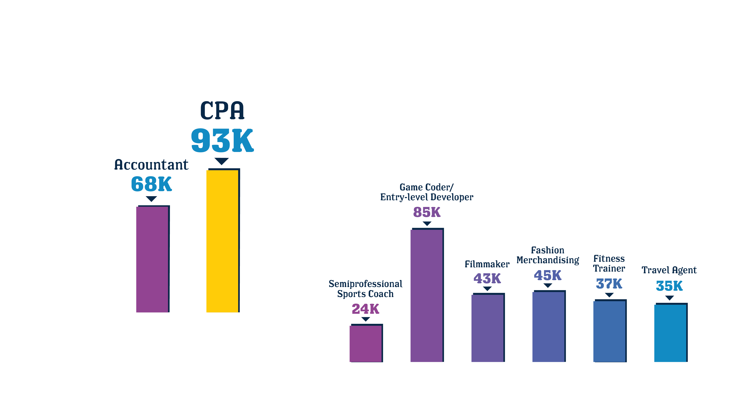
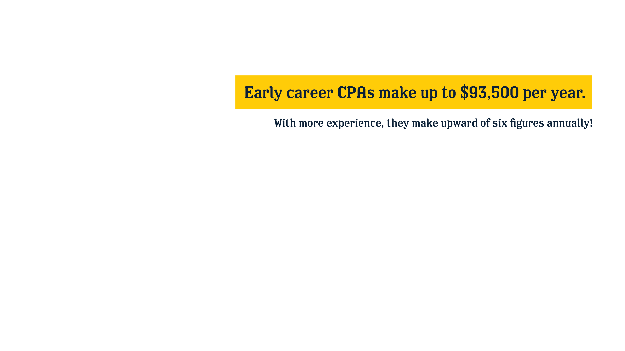
Notes:
Slide 6- Money Matters
Introduction- Now let’s shift our focus to an important aspect of any career: income. On this slide, we’ll explore the earning potential for accountants and how compensation can vary within the field.
Entry level CPAs can make $93,500 per year. With more experience, they make upward of six figures annually!
*Students may ask you about your income and starting salary, share to the level you are comfortable with*
Recap- By reviewing this information, I hope you now have a better grasp of the financial aspects of pursuing an accounting career and how it aligns with your long-term goals. With this understanding, you can make more informed decisions about your career path.

Slide 8

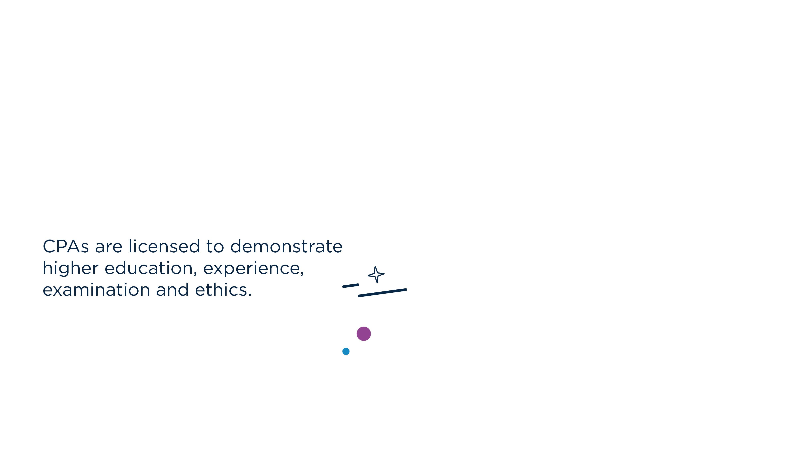


Notes:
Introduction: Next, let’s clarify an important distinction in the field of accounting: the difference between an Accountant and a Certified Public Accountant, or CPA.
CPAs are licensed to demonstrate higher education, experience, examination and ethics
Earn higher salaries
Frequently receive higher-level promotions
Experience greater job security
Can become more specialized
Receive more respect and trust
Have a competitive edge
Recap- With this knowledge, you can better align your career aspirations with the qualifications and roles that suit your goals. Let’s proceed to explore more about the various career opportunities and paths within the accounting profession.

Slide 9




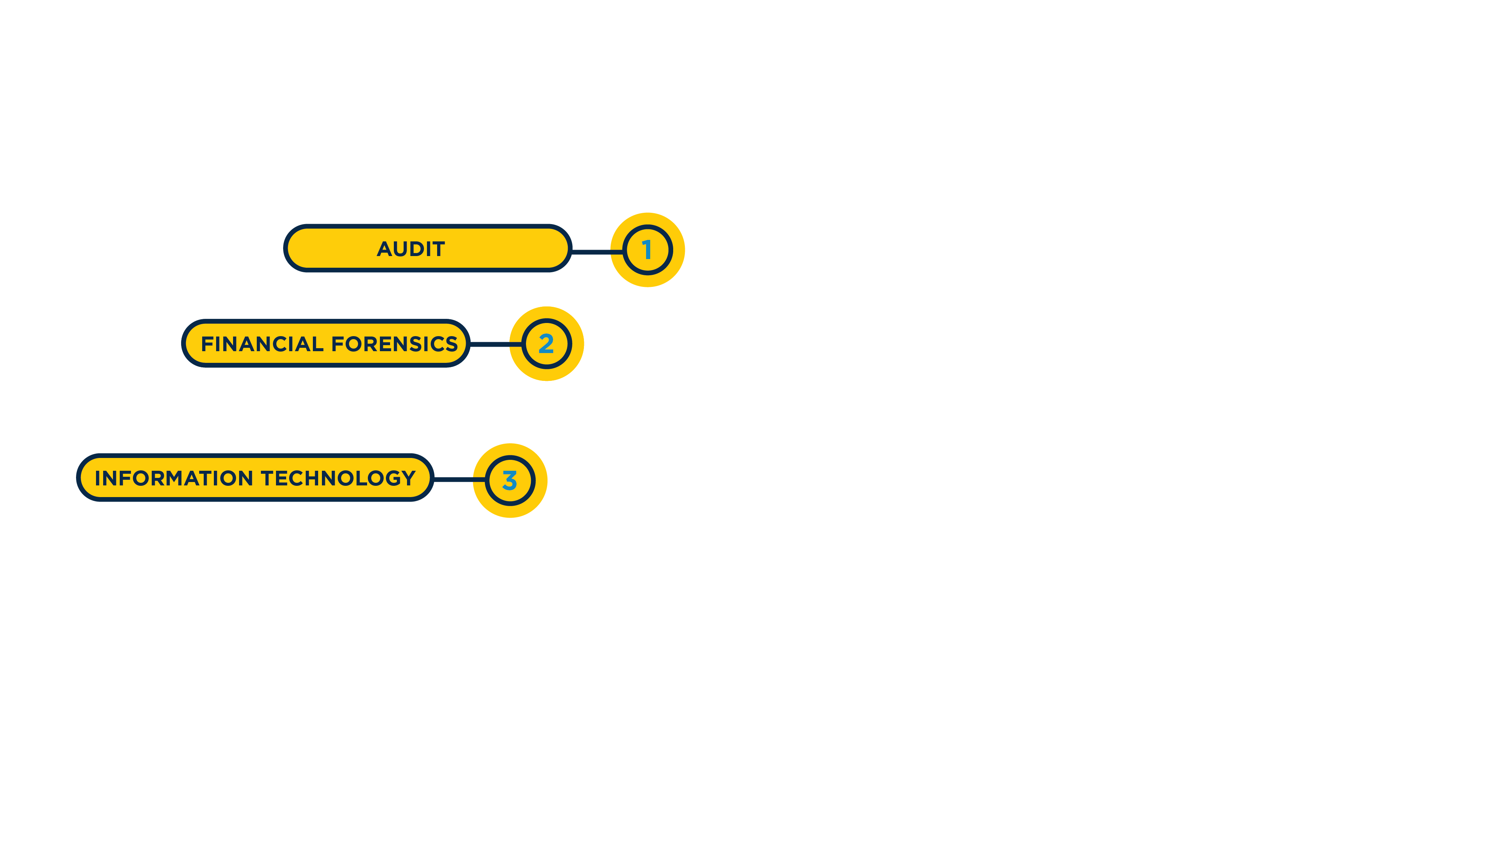
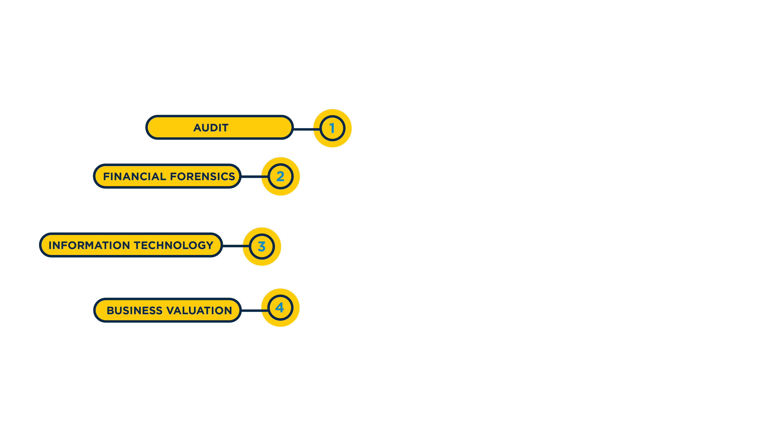
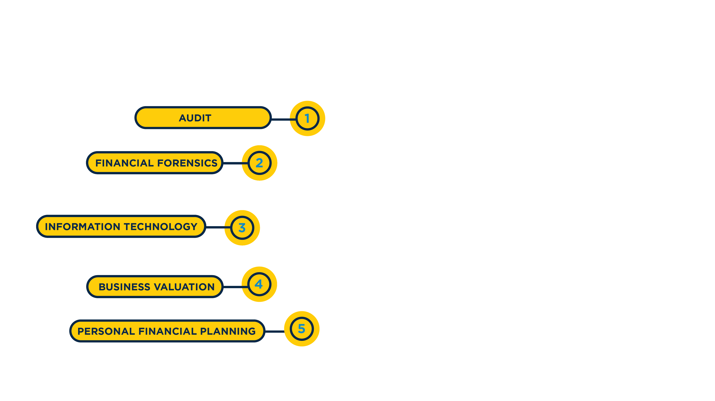
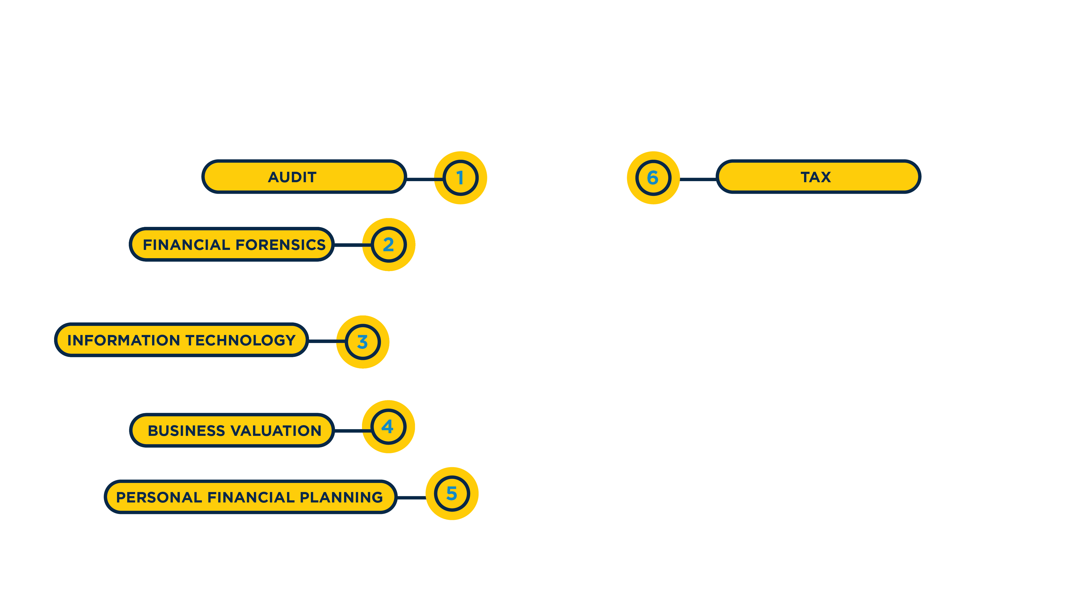
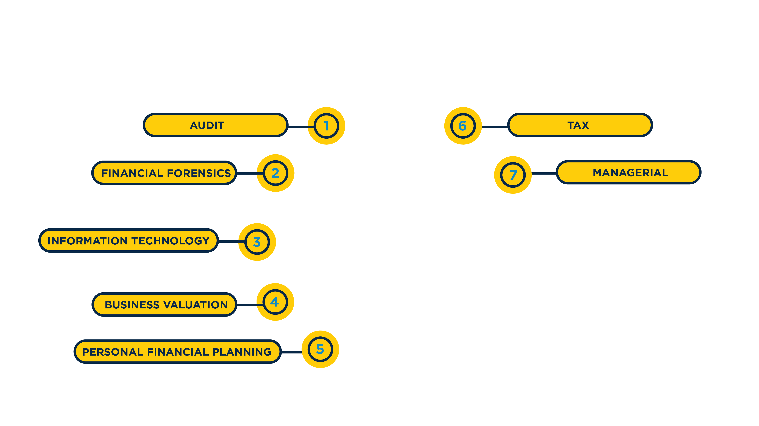
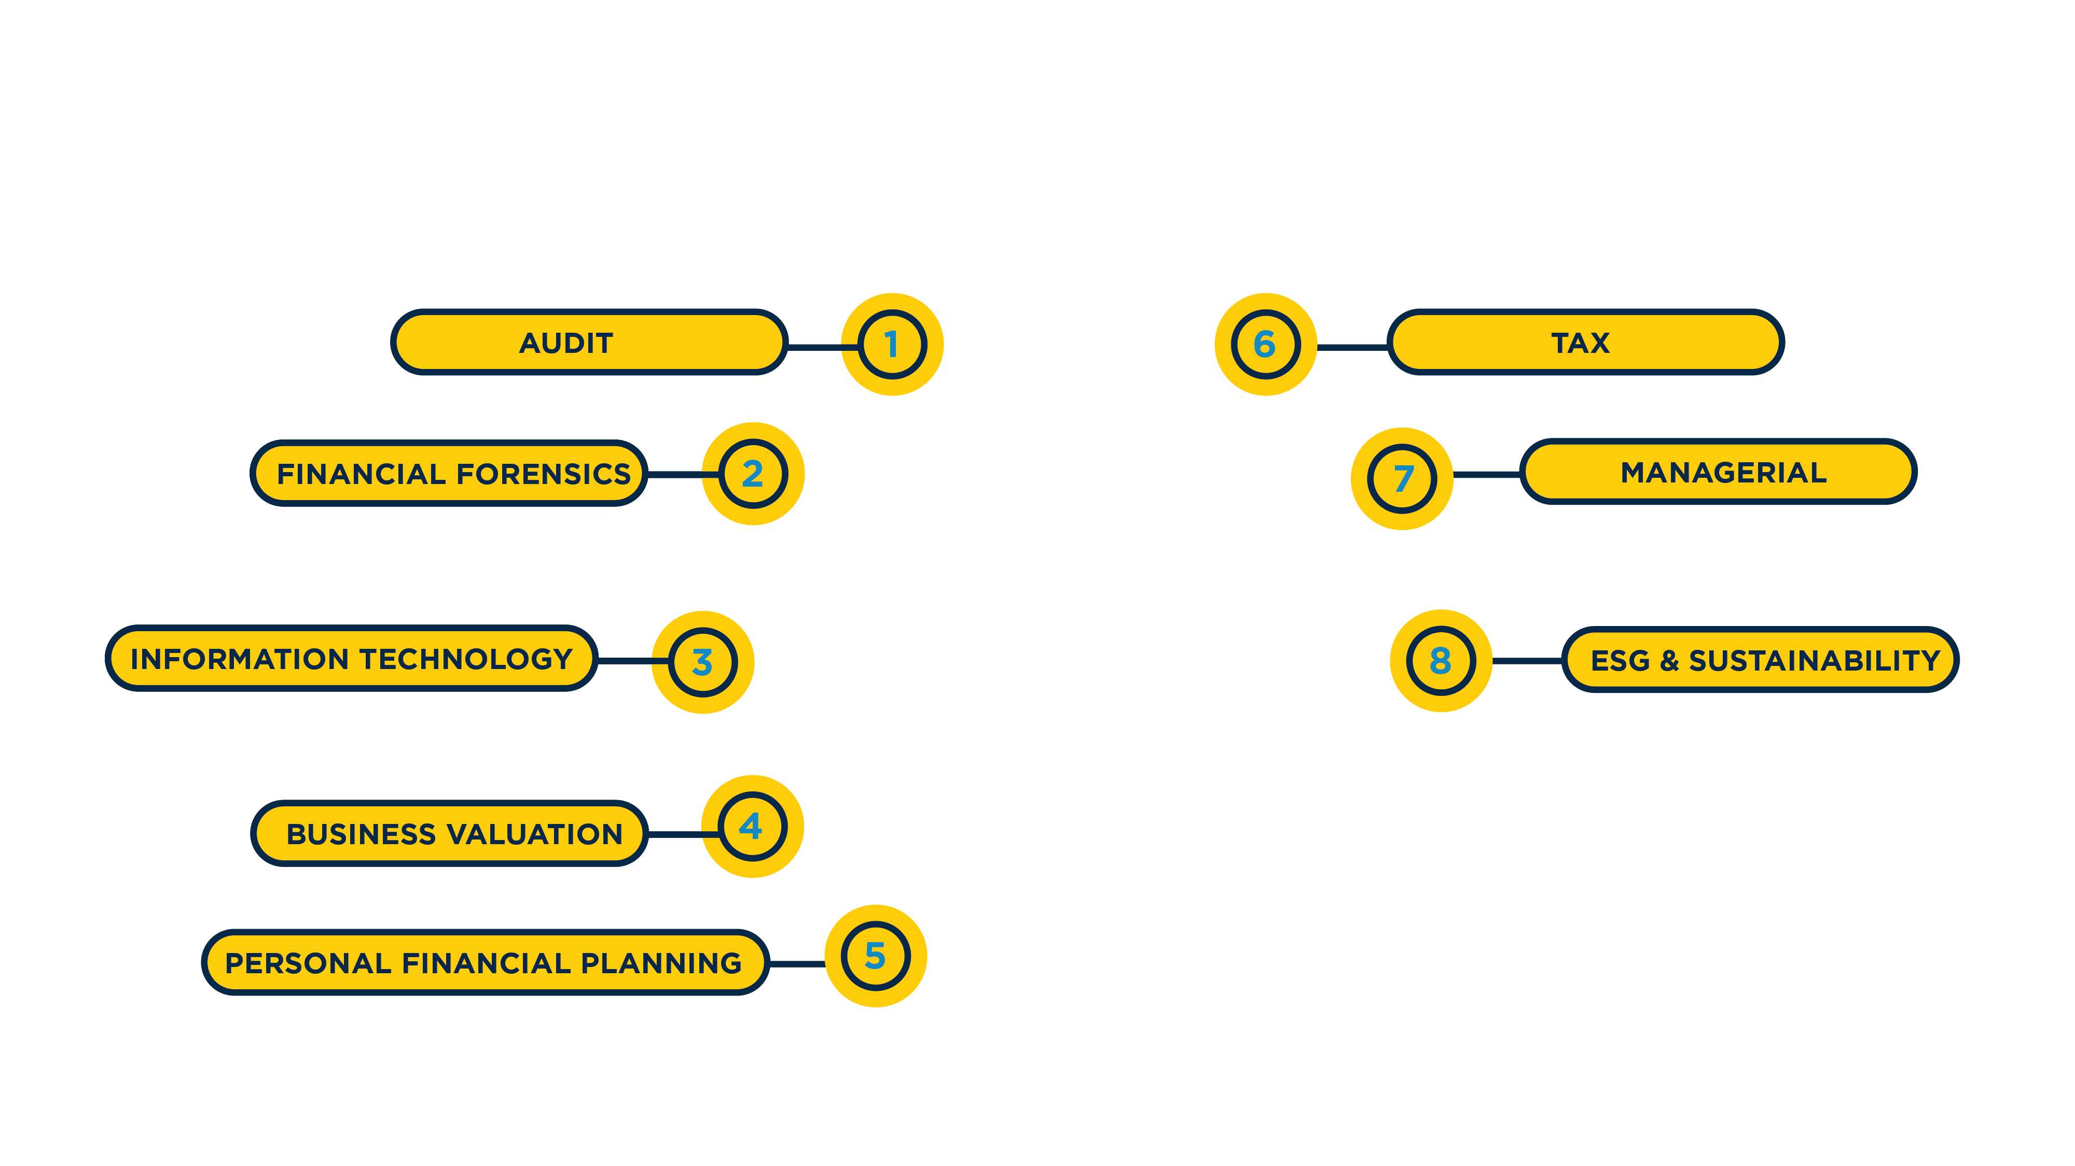
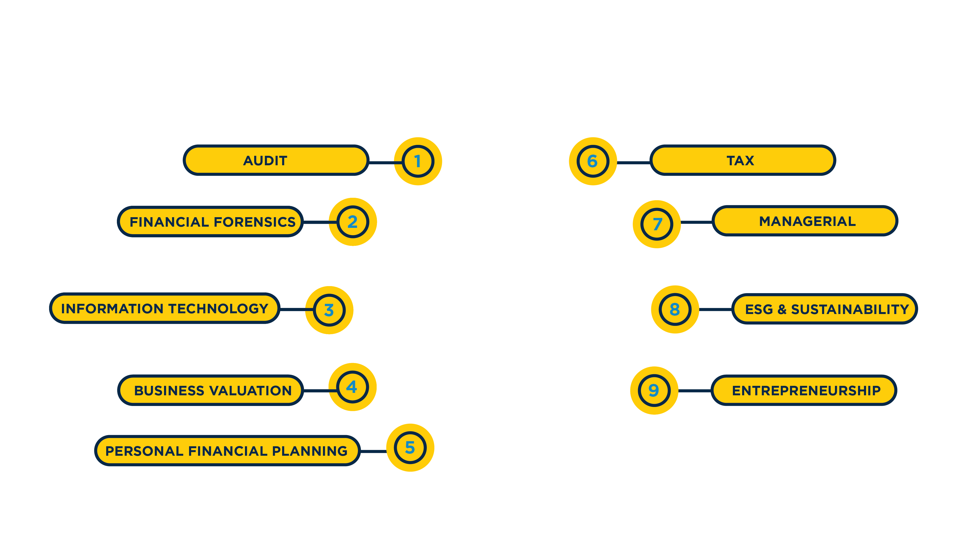
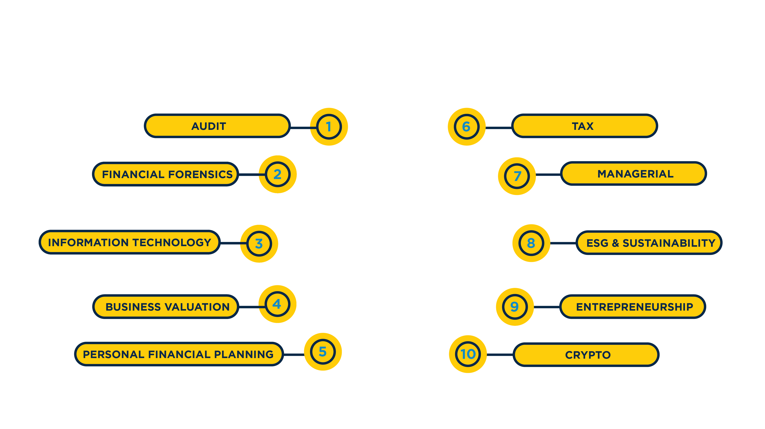
Notes:
Introduction: Accounting is a diverse profession with a wide range of career paths, each offering unique challenges and rewards. From traditional roles in financial management to specialized areas such as forensic accounting and tax advisory, there are numerous avenues you can pursue.
Specializations- Once you obtain the knowledge of core accounting principles, you’ll have the ability to choose a specialization.
Audit- Doing the detective work of investigating whether companies are operating ethically
Financial Forensics- Working inside-and outside- the courtroom by investigating cases of corporate fraud and bankruptcy
Information Technology- Using technology to solve business problems and improve efficiency
Business Valuation- Determining the true value of companies in advance of mergers and acquisitions
Personal Financial Planning- Helping individuals by strategically advising on savings, investments, and risk management
Tax- Navigating the ever-changing world of tax accounting
Managerial- Combining financial analysis and business acumen to help companies grow
ESG & Sustainability- Focusing on helping businesses improve environmental sustainability
Entrepreneurship- Owning your own business or helping individuals start their own business
Crypto- Managing and monitoring the changing values of digital assets
Recap- There are a broad range of careers in accounting that will best fit your goals and aspirations.

Slide 10








Notes:
Introduction: As you continue exploring your path in accounting, it's important to know where you can find support and resources to help you succeed. The NJCPA is a nonprofit organization that supports individuals throughout their entire career – beginning with their education. They guide students in their accounting education, offer financial support, connect them to internships and then to job opportunities. They currently serve 13,000 members who are students, educators, accountants, CPAs and business owners.
Scholarships- The NJCPA offers scholarships for both High School seniors and College students. (More to come on next slide)
Student membership- FREE membership is available for college students.
Career development – They provide the knowledge and tools to develop your skills, expertise and plan for advancement.
CPA Exam preparation- They walk candidates through the process of studying for, applying for and taking the exam.
Job connections- The NJCPA is home to over 13,000 members who are currently working in the profession. They can connect students with industry professionals.

Slide 11









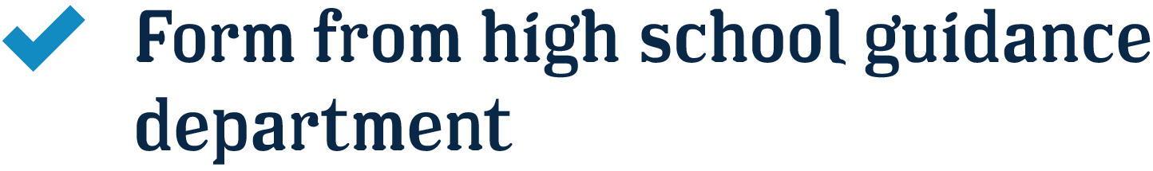


Notes:
Introduction: Providing scholarships to high school seniors and college students is one way the NJCPA supports aspiring CPAs with reaching their career goals. Every year, accounting students can apply for financial awards and receive as much as $6,500 when they are college juniors. If you are interested in studying accounting in college, I encourage you to apply for a scholarship from the NJCPA. Visit the website for more details about eligibility and the application.
$1,500 Scholarships for High School Seniors
Qualifications:
Enter accounting-related college program
Short essay
Form from high school guidance department
Minimum 3.2 GPA

Slide 12


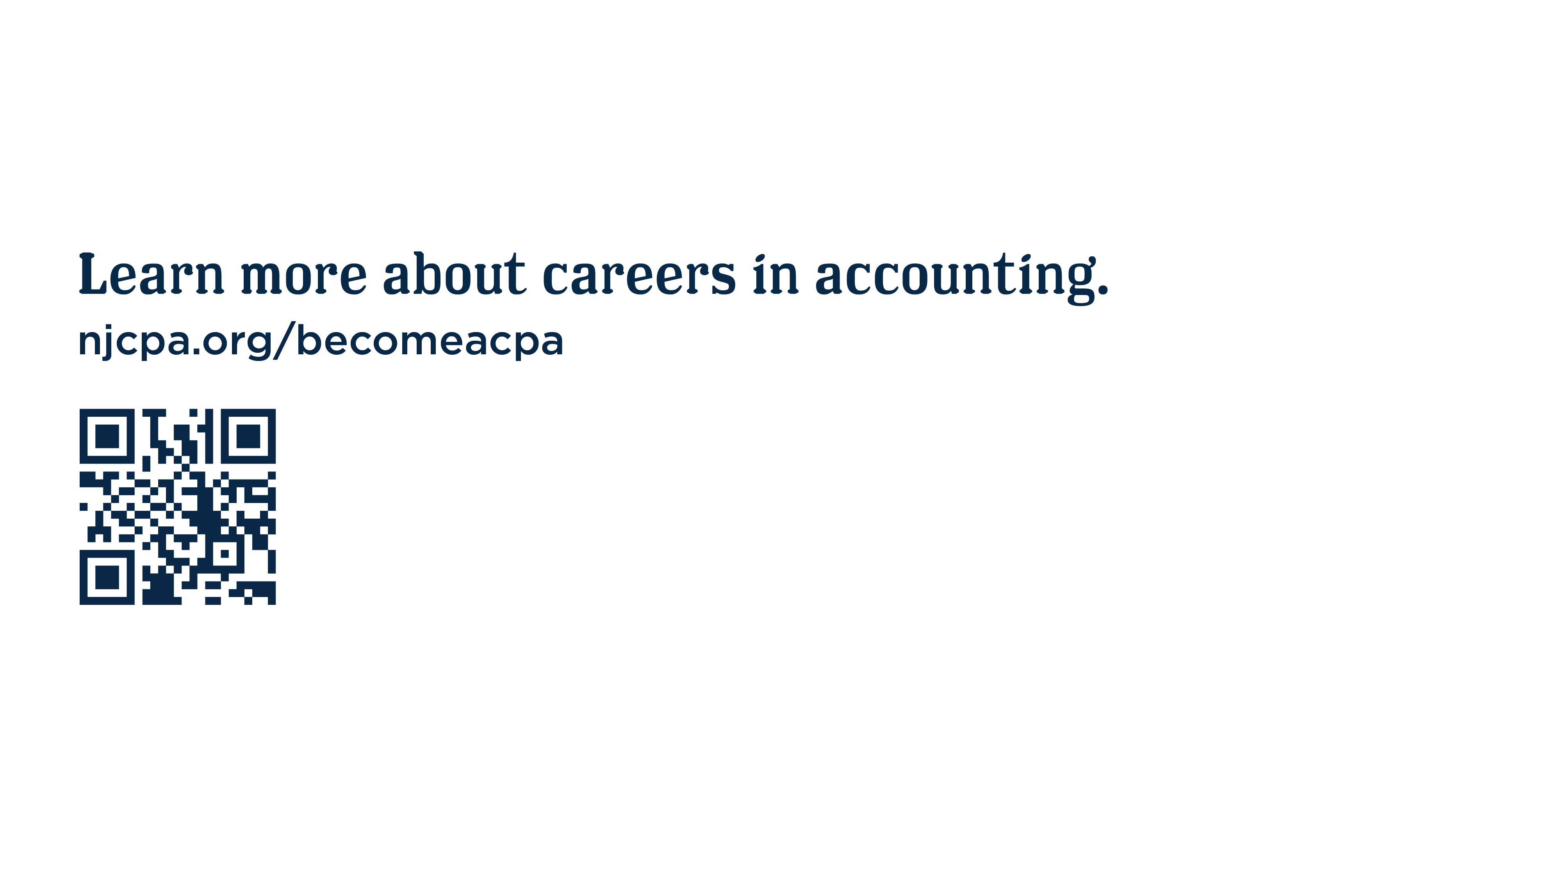
Notes:
As we come to the end of our presentation, I want to extend a heartfelt thank you to each of you for your time and attention.
We’ve covered a lot of ground today, from exploring the various facets of accounting and the exciting career opportunities available, to understanding the support and resources offered by organizations like the NJCPA.
I hope you found the information valuable and insightful as you consider your future in the accounting profession. If you have any questions or need further information, please feel free to reach out.
Thank you once again for participating, and best of luck as you embark on your journey in accounting.
*Take questions if desired, and offer email if comfortable*

